Slide 1

OPERATION TECHNOLOGY
10.10.26
WEEKLY TASKS OF
OT - RnD Team

Slide 2
TABLE OF CONTENTS
S NO | CONTENT
1 | CURRENT WEEEK TASKS
2 | NEXT WEEK PLAN TASKS
3 | HARDWARE, FIRMWARE AND INDUSTRIAL ROBOT STATUS
4 | GATEWAY DEVICE COST BREAKDOWN
5 | PO STAGE DEATILS

Slide 3
CURRENT WEEK TASKS 05.10.26 - 10.10.26
S. No. | Name | Project | Task | PLanned Start Date | Planned End Date | Actual Start Date | Actual End Date | Comments
Firmware
1 | Rithani | Gateway Device | Rollback firmware development and testing | 05.10.26 | 05.10.26 | 05.10.26 | 05.10.26 | Gateway firmware completion; testing after PCB availability
Hardware
7 | Aswin | Gateway Device | PCB silkscreen updates, 3D modelling, and verification | 06.10.26 | 07.10.26 | 06.10.26 | 07.10.26
Industrial Robot
6 | Noufal & Rithani | Industrial Robot | Robot presentation (PPT) | 08.10.26 | 10.10.26 | 08.10.26 | 10.10.26
Stitch Detection
10 | Noufal | Stitch Detection | Hardware requirement discussions | 09.10.26 | 09.10.26 | 09.10.26 | 09.10.26
Learning
3 | Rithani | ROS 2 / Robotics | Installed ROS 2 on Raspberry Pi and learned Ubuntu commands | 07.10.26 | 07.10.26 | 07.10.26 | 07.10.26
2 | Rithani | KiCad | KiCad learning and implementation | 06.10.26 | 06.10.26 | 06.10.26 | 06.10.26
9 | Aswin | SolidWorks | SolidWorks learning | 08.10.26 | 08.10.26 | 08.10.26 | 08.10.26
PPTs and Excel
4 | Noufal & Rithani | Documentation | SMD, MBD Gateway, and Stitch Analysis presentations | 07.10.26 | 07.10.26 | 07.10.26 | 07.10.26
5 | Noufal & Rithani | Documentation | MBD and CAPEX requirement sheet preparation in Excel | 08.10.26 | 08.10.26 | 08.10.26 | 08.10.26
8 | Aswin | Planning | Two-year plan preparation in Excel | 08.10.26 | 09.10.26 | 08.10.26 | 09.10.26

Slide 4
NEXT WEEK PLAN TASKS12.10.26 - 17.10.26 PLAN
S NO | NAME | PROJECT | TASK | START DATE | END DATE | COMMENTS
Learning / Hardware
1 | Aswin | Gateway Device | Learning and implementing enclosure design | 12.10.26 | 17.10.26
2 | Rithani | Industrial Robot | Learning ROS 2, and try a basic project | 12.10.26 | 17.10.26
Industrial Robot
3 | Noufal | Industrial Robot | Requirement collection for the robot | 12.10.26 | 14.10.26
4 | Rithani | Industrial Robot | Documentation of robot requirements | 12.10.26 | 14.10.26
5 | Noufal | Industrial Robot | Initiate AC servo testing | 15.10.26 | 17.10.26
Stitch Detection
6 | Noufal | Stitch Detection | Explanation of the project to SMD people | 12.10.26 | 12.10.26
7 | Noufal | Stitch Detection | Conduct weekly meeting on stich detection project progress | 16.10.26 | 16.10.26

Slide 5
HARDWARE:
THIS WEEK: Complete PCB routing by finalizing track connections, optimizing component placement, and ensuring proper routing clearances. Perform PCB design verification to check electrical connectivity, design rule compliance, and potential layout errors before fabrication. Generate 3D models for all components to validate component dimensions, placement accuracy, and compatibility with the overall PCB assembly. NEXT WEEK: Design the top enclosure of the Gateway Device, considering component accessibility, mounting provisions, and external interface requirements. Design the bottom enclosure with suitable PCB mounting points, structural support, and provisions for secure assembly. Finalize the enclosure design for sheet metal fabrication by validating dimensions, material requirements, and mechanical fit. | DEPENDENCIES: Learn SolidWorks fundamentals to develop the required skills for designing the Gateway Device enclosure. Focus on sheet metal design techniques, including bends, cutouts, and mounting features. Understand sheet metal fabrication requirements to ensure the enclosure design is practical, manufacturable, and cost-effective.
 | RISKS: Delay in receiving the Purchase Order (PO) may postpone PCB fabrication and procurement activities. Procurement delays could affect the planned development, assembly, and testing schedule. Timely PO release and confirmation are essential to minimize schedule disruptions and maintain project progress.

Slide 6
FIRMWARE:
THIS WEEK: Develop OTA rollback functionality for the Gateway Device to ensure automatic recovery to the previous stable firmware in case of an unsuccessful update. Perform OTA rollback testing by simulating firmware update failures, verifying rollback behavior, and confirming successful device recovery. Begin learning ROS 2 fundamentals for robotics firmware development. NEXT WEEK: Prepare an industrial robotics presentation covering robot architecture, joint mechanisms, key components, motion control, and system integration. Continue learning ROS 2 concepts. Implement basic ROS 2 programs. | DEPENDENCIES: Require the PCB ready for firmware testing. Complete hardware assembly is required to proceed with integration and system-level testing.
 | RISKS: Any unresolved firmware issues may further delay actual deployment if sufficient testing time is unavailable.

Slide 7
INDUSTRIAL ROBOT:
THIS WEEK: Plan and coordinate AC servo testing at Annur, where the required communication cable is available. Prepare the industrial robotics presentation, covering the project overview and key objectives. Complete the Robot at a Glance and In-house vs. Outsourcing sections of the presentation. NEXT WEEK: Complete the industrial robotics presentation, including the remaining technical details and project scope. Initiate AC servo testing at Annur using the available communication cable. Verify servo communication and basic operational functionality as part of the initial testing process. | DEPENDENCIES: The AC servo must be transported to Annur through the DC for testing. Coordination of servo transportation and hardware availability is essential to begin testing as planned.
 | RISKS: Delays in servo testing could affect the testing timeline and validation activities.

Slide 8
UNIVERSAL GATEWAY DEVICE COST DETAILS
S No. | Milestone Payment % | Milestone Payment Description | Amount (₹) | Planned Invoice Date | Actual Invoice Date | Invoice No. | Payment Status | Remark
1 | 0% | PHASE 1 DEVICE | ₹₹6,000 | NOV-2026 |  |  | Pending | WAITING FOR APPROVAL AT SMD
2 | 0% | PHASE 2 DEVICE | ₹29,000 | NOV-2026 |  |  | Pending | WAITING FOR APPROVAL AT SMD
3 | 0% | WORK BENCH COMPONENTS | ₹85,753 | NOV-2026 |  |  | Pending | WAITING FOR APPROVAL FROM MD
Total | 0% |  | ₹1,17,753

Slide 9
S No. | Vendor | Cost | PO Stage 1: quotation and vendor details collection | PO Stage 2: vendor code creation | PO Stage 3: Component info creation | PO Stage 4: PO generation | PO Stage 5: profama invoice from vendor | PO Stage 6: payment from our side | Remark
1 | Robu - gateway | 31,833 | ✅ | ✅ | ✅ | ✅ OCT 5 | ⏳ |  | Vendor side waiting
2 | Sharvi - gateway | 3,833 | ✅ | ✅ | ✅ | ✅ OCT 5 | ⏳ |  | Vendor side waiting
3 | Element14 - gateway | 2,489 | ✅ | ✅ | ✅ OCT 6 | ⏳ |  |  | Vendor should create ASN for further process
4 | Vichrak - vamaan board | 18,999 | ✅ OCT 8 | NA | NA | NA | NA | ⏳ | Veeraboopathy Sir yet to place order
5 | Robu - pi, cam, for stich detection | 6,935 | ✅ OCT 8 | NA | NA | NA | NA | ⏳ | Veeraboopathy Sir yet to place order
6 | Amazon - encloser for stich detection | 500 | ✅ OCT 8 | NA | NA | NA | NA | ⏳ | Veeraboopathy Sir yet to place order
7 | Robu - Workbench | 31,636 | ⏳ |  |  |  |  |  | Waiting for MD aprroval
8 | Sharvi - workbench | 18,763 | ⏳ |  |  |  |  |  | Waiting for MD aprroval

Slide 10
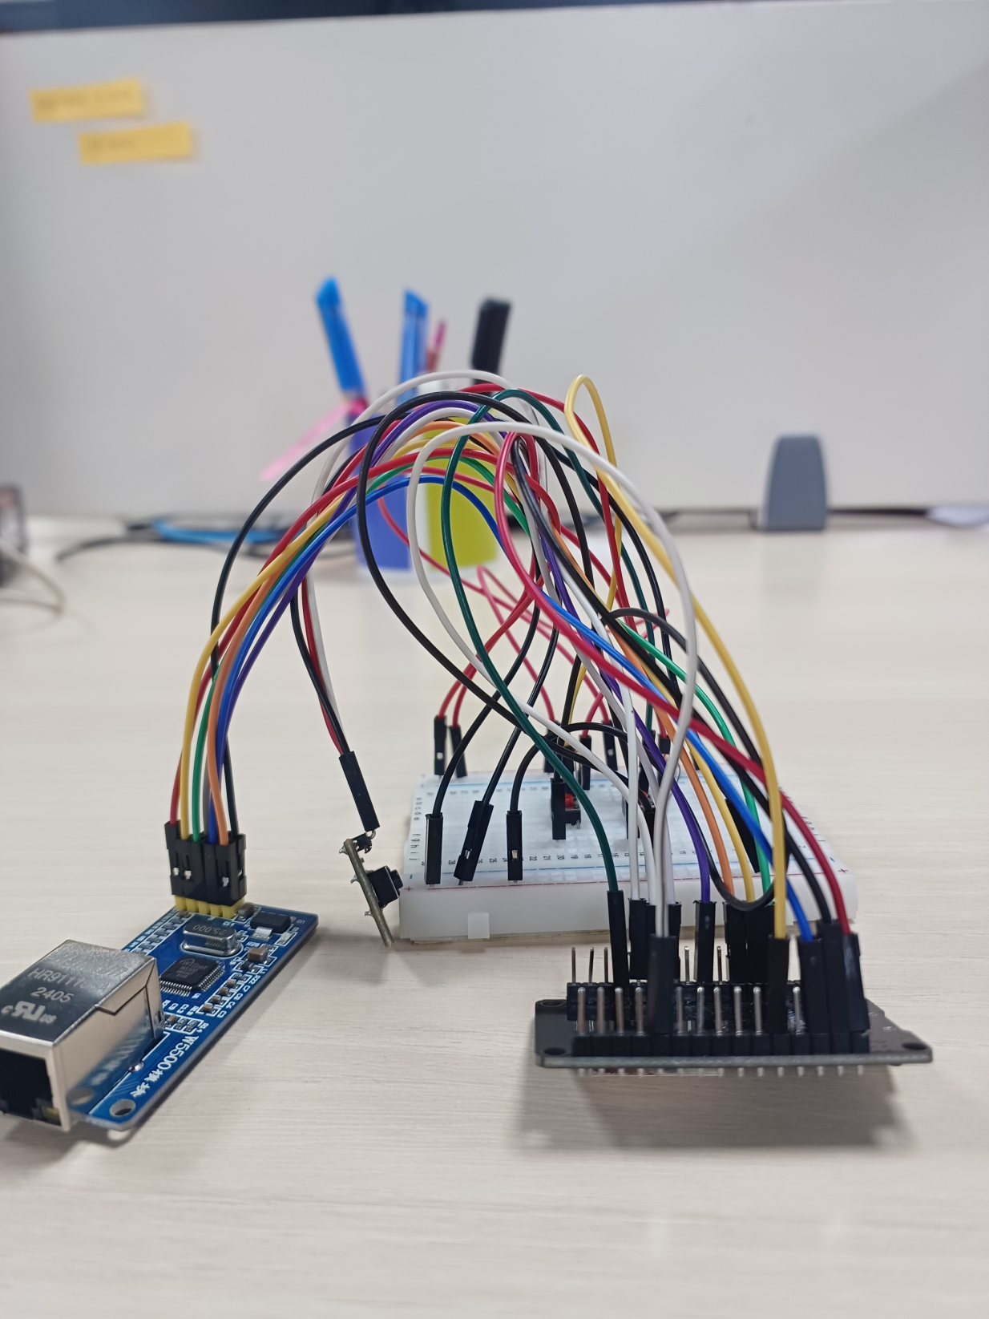
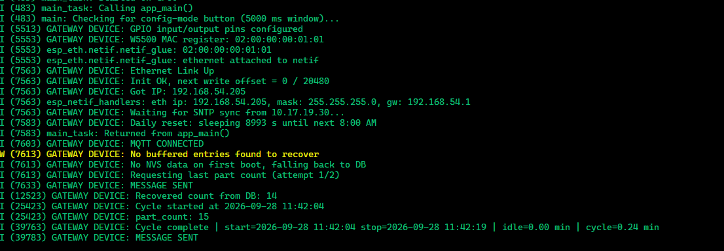
GATEWAY DEVICE:
Currently firmware completed, initial testing will proceed after we get PCB
Vision 0

Slide 11
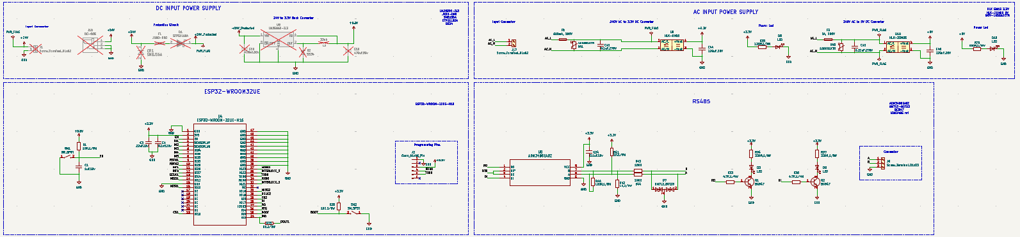
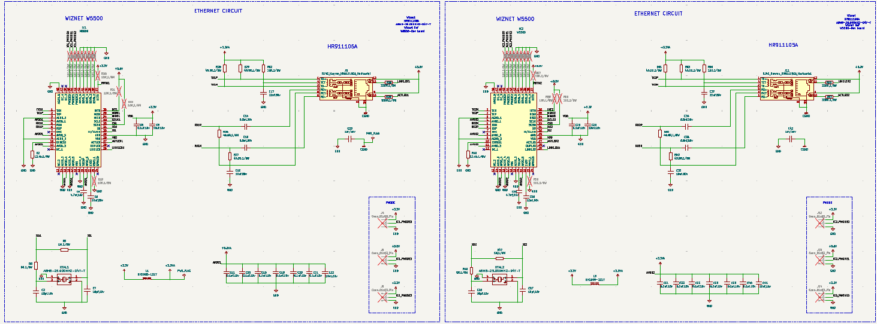
GATEWAY DEVICE:
Components acquring is in process of SMD PR approval. PCB designing completed, encloser design ongoing
Vision 0

Slide 12
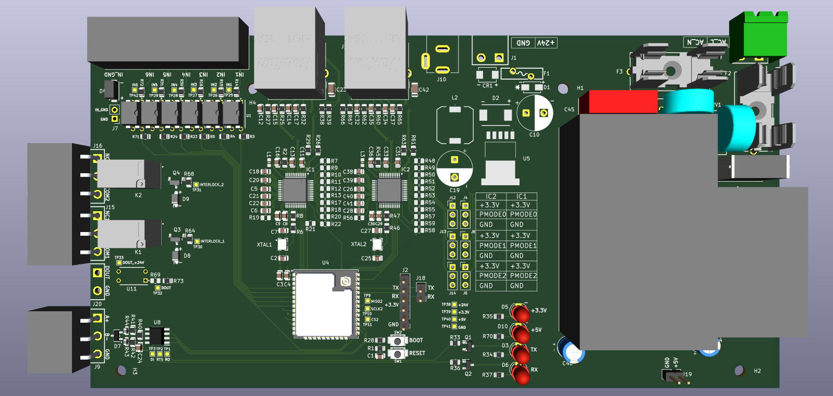
GATEWAY DEVICE:

Slide 13
Thank you

